Slide 1

Chapter 8
Switching
School of Computer Science and Engineering
Pusan National University
Jeong Goo Kim

Slide 2
Ch. 8 Outline
    Outline
8.1 Introduction
8.2 Circuit-Switched Network
8.3 Packet-Switching
8.4 Structure of a Switch

Slide 3
    Ch. 8 Objective
    Objective
three methods of switching
  circuit switching,
  packet switching,
  and message switching

Slide 4
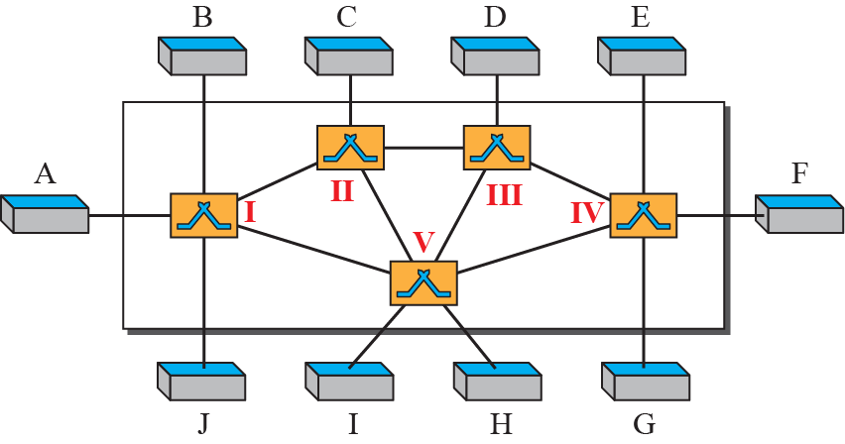
    8.1 Introduction
    8.1 Introduction
A network is a set of connected devices.
A switched network consists of a series of interlinked nodes, called switches.
Fig. 8.1 Switched network

Slide 5
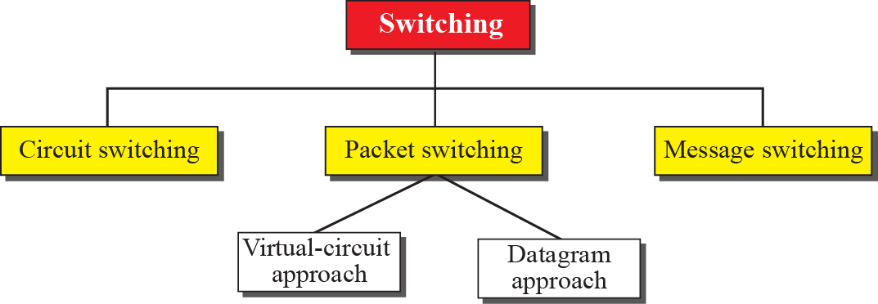
    8.1 Introduction
    8.1.1 Three Methods of Switching
Fig. 8.2 Taxonomy of switched networks

Slide 6
    8.1 Introduction
    8.1.2 Switching and TCP/IP Layers
Switching can happen at several layers of the TCP/IP protocol suite:
  at the physical layer,
  at the data-link layer,
  and at the network layer.

Slide 7
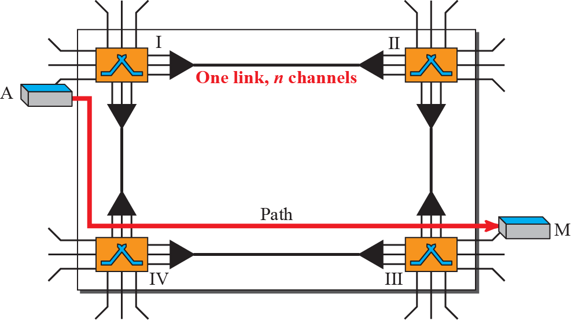
    8.2 Circuit-Switched Networks
    8.2 Circuit-Switched Networks
consists of a set of switches connected by physical links.
each connection uses only one dedicated channel on each link.
each link is normally divided into n channels by using FDM or TDM
Fig. 8.3 A trivial circuit-switched network

Slide 8
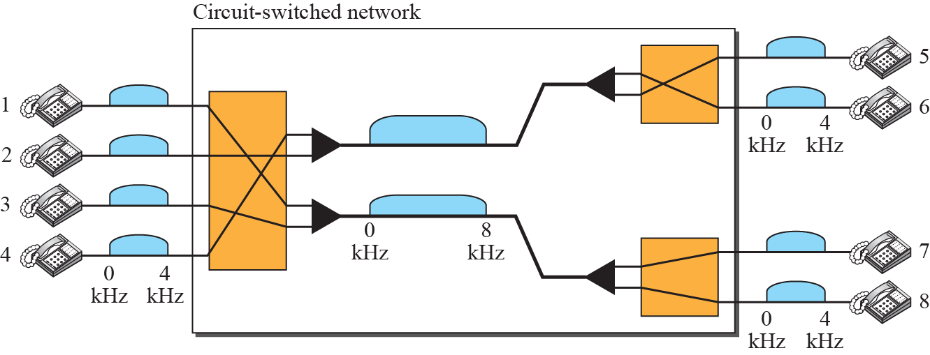
    8.2 Circuit-Switched Networks
Fig. 8.4 Circuit-switched network used in Example 8.1

Slide 9
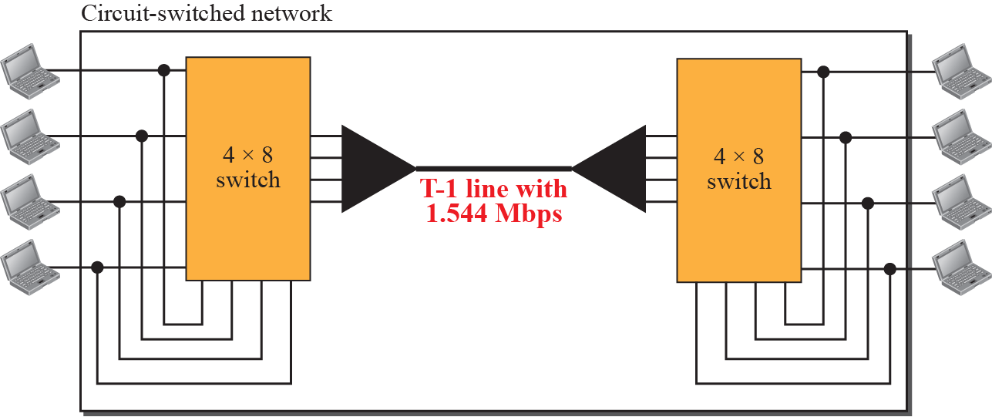
    8.2 Circuit-Switched Networks
Fig. 8.5 Circuit-switched network used in Example 8.2

Slide 10
    8.2 Circuit-Switched Networks
    8.2.1 Three Phase
circuit-switched network requires three phases:
  connection setup,
  data transfer,
  and connection teardown.

Slide 11
    8.2 Circuit-Switched Networks
    8.2.2 Efficiency
It can be argued that circuit-switched networks are not as efficient as the other two types of networks because resources are allocated during the entire duration of the connection. These resources are unavailable to other connections. In a telephone network, people normally terminate the communication when they have finished their conversation.
    8.2.3 Delay
Although a circuit-switched network normally has low efficiency, the delay in this type of network is minimal. During data transfer the data are not delayed at each switch; the resources are allocated for the duration of the connection. Figure 8.6 shows the idea of delay in a circuit-switched network when only two switches are involved.

Slide 12
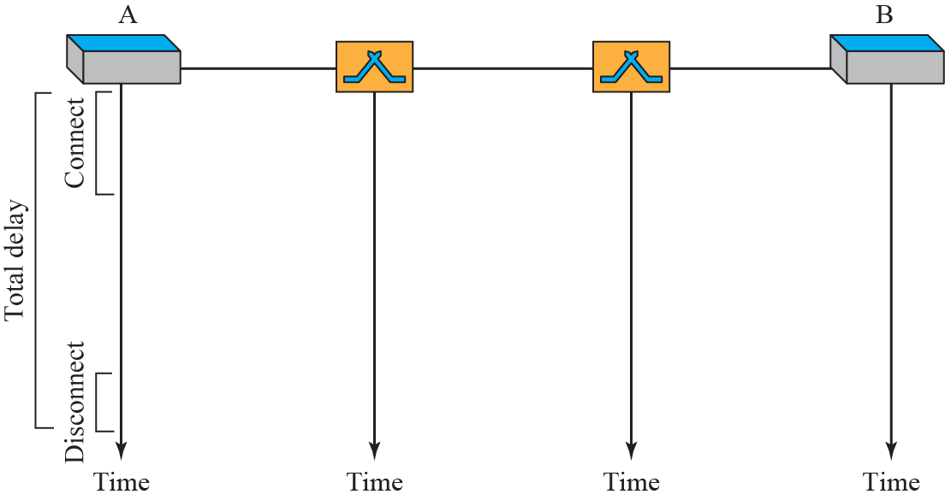
    8.2 Circuit-Switched Networks
Fig. 8.6 Delay in a circuit-switched network

Slide 13
    8.3 Packet Switching
    8.3 Packet Switching
In a packet-switched network, message is divided into packets of fixed or variable size.
The size of the packet is determined by the network and the governing protocol.

Slide 14
    8.3 Packet Switching
8.3.1 Datagram Networks
In a datagram network, each packet is treated independently of all others.
Even if a packet is part of a multipacket transmission, the network treats it as though it existed alone.
Packets in this approach are referred to as datagrams.

Slide 15
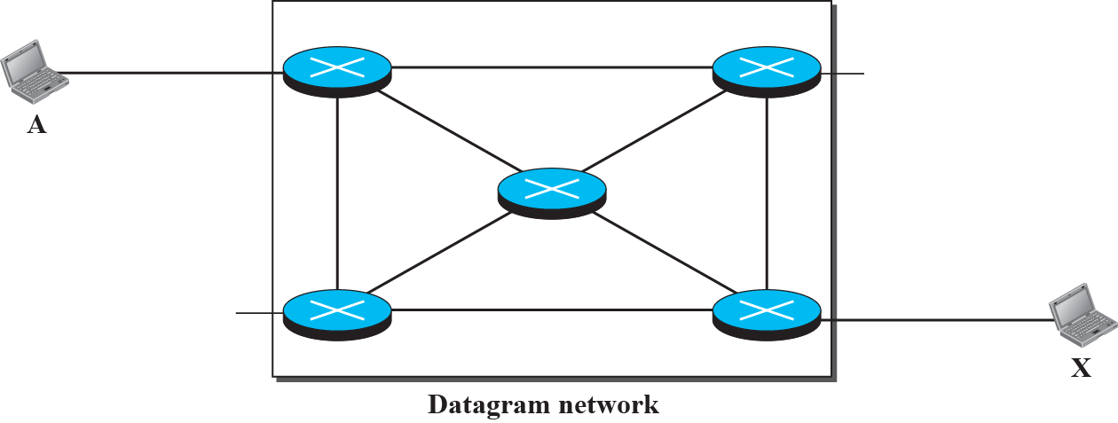
    8.3 Packet Switching
Fig. 8.7 A Datagram network with four switches (routers)

Slide 16
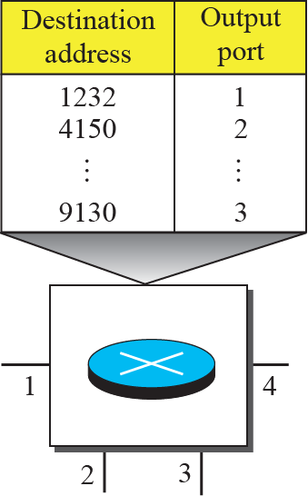
    8.3 Packet Switching
Fig. 8.8 Routing table in a datagram network

Slide 17
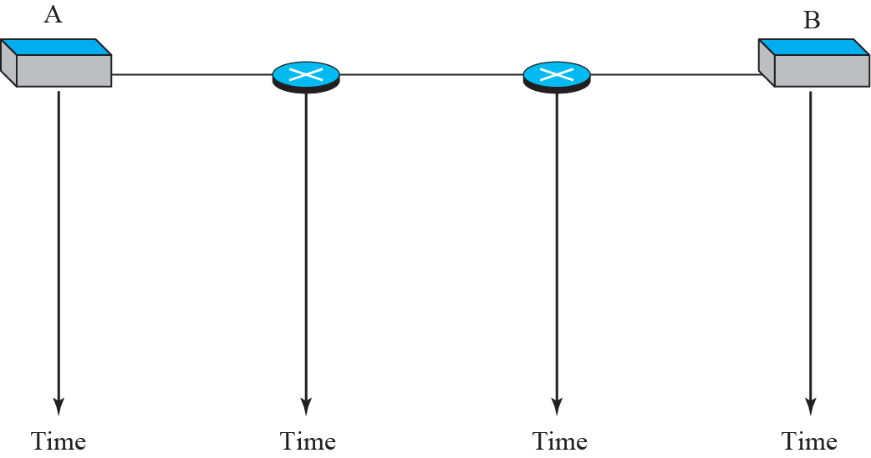



    8.3 Packet Switching
Fig. 8.9 Delays in a datagram network

Slide 18
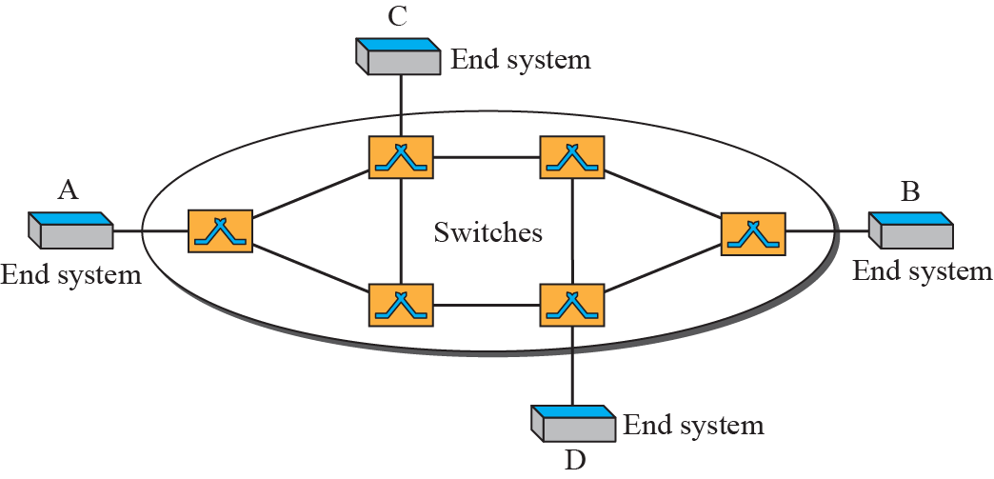
    8.3 Packet Switching
8.3.2 Virtual-Circuit Networks
is a cross between a circuit-switched network and a datagram network.
has some characteristics of both.
Fig. 8.10 Virtual-circuit network

Slide 19
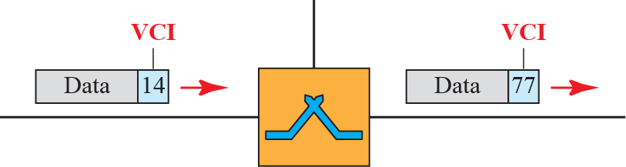
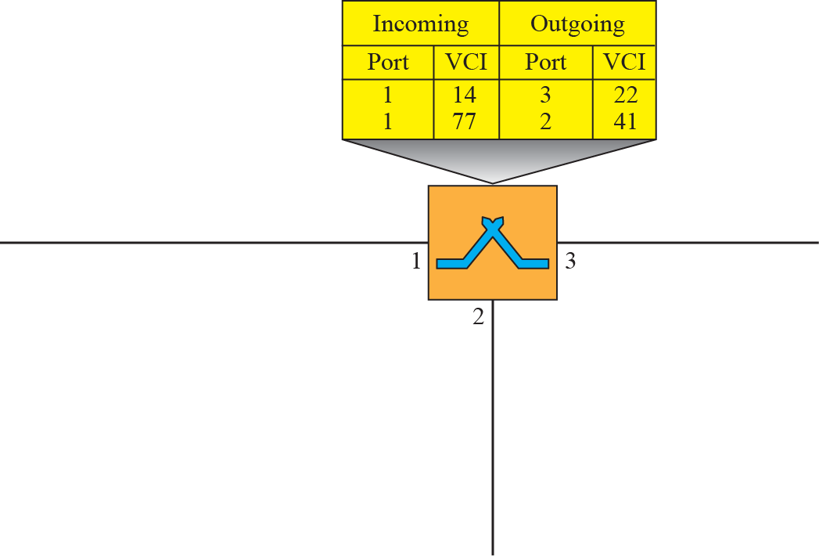



    8.3 Packet Switching
Fig. 8.11 Virtual-circuit identifier
Fig. 8.12 Switch and table for a virtual-circuit network

Slide 20
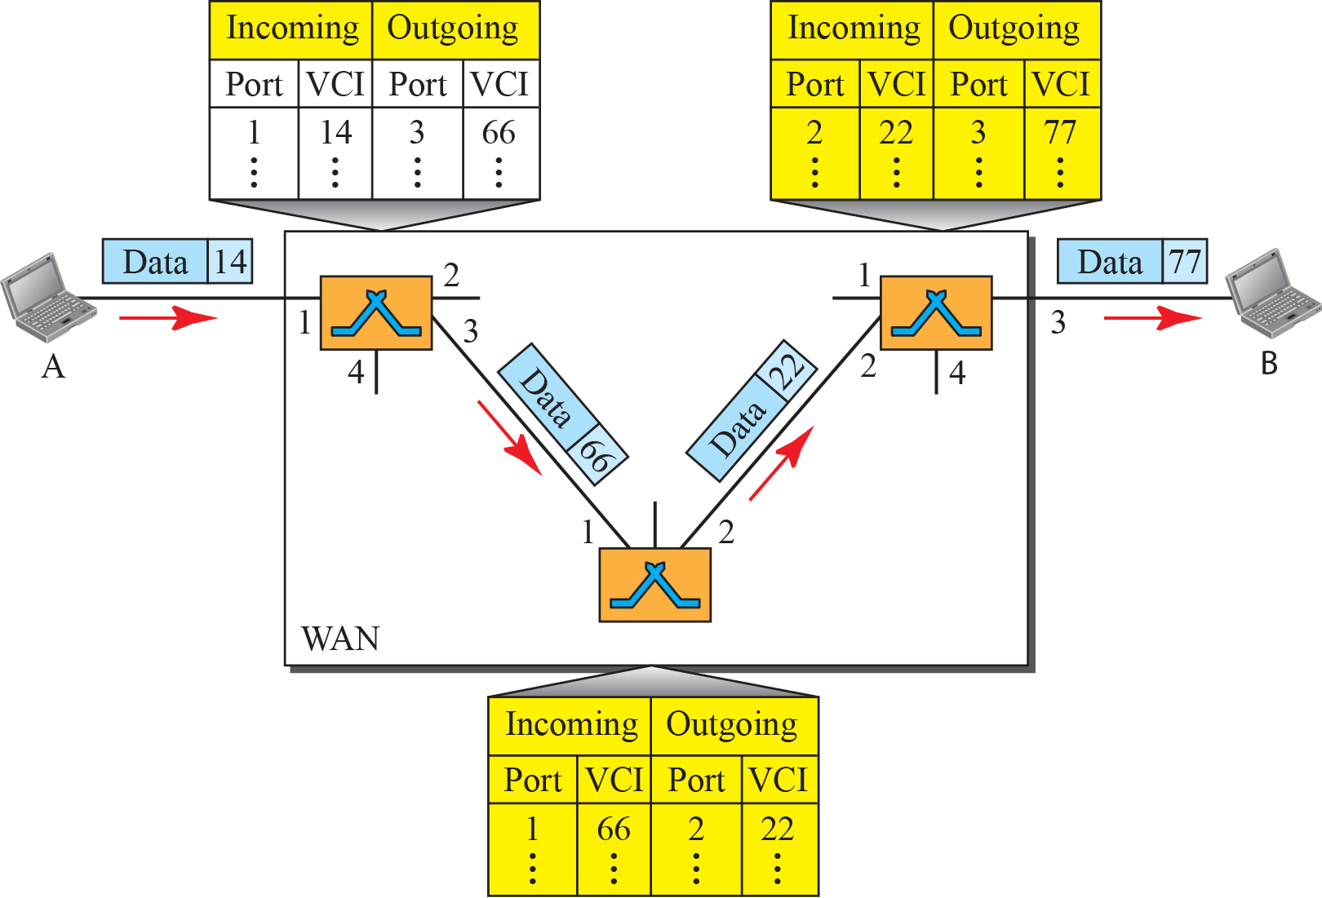
    8.3 Packet Switching
Fig. 8.13 Source-to-destination data transfer in a virtual-circuit network

Slide 21
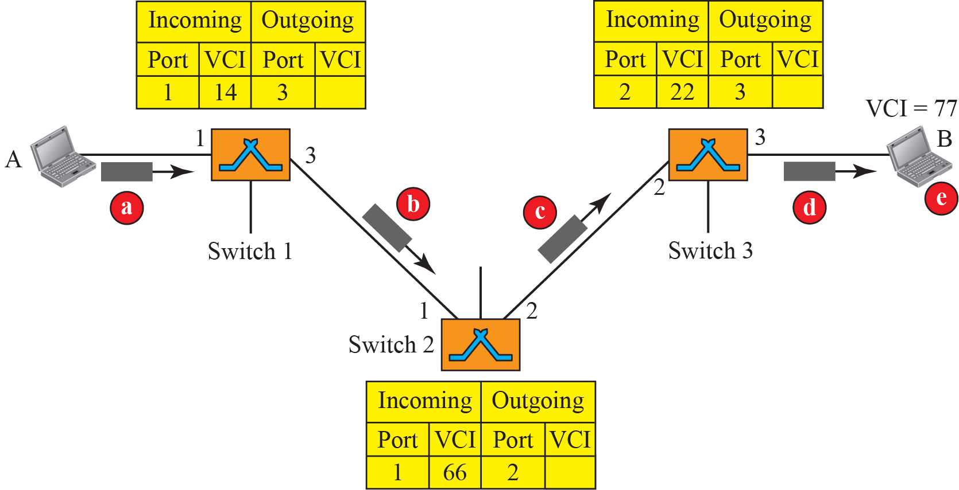
    8.3 Packet Switching
Fig. 8.14 Setup request in a virtual-circuit network

Slide 22
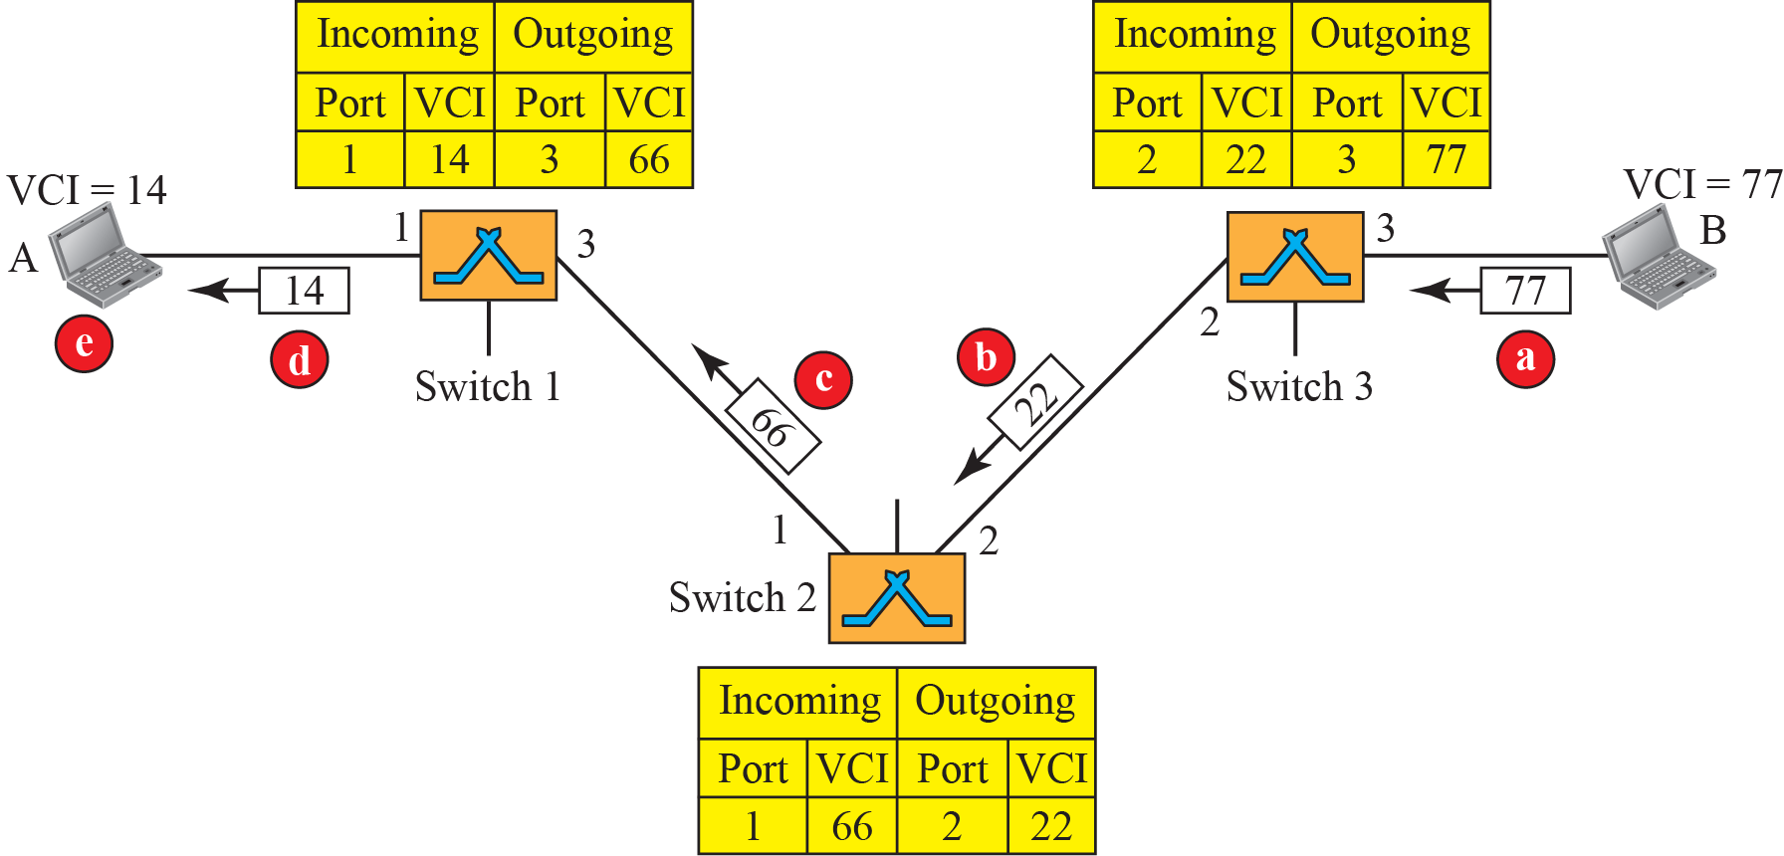
    8.3 Packet Switching
Fig. 8.15 Setup acknowledgment in a virtual-circuit network

Slide 23
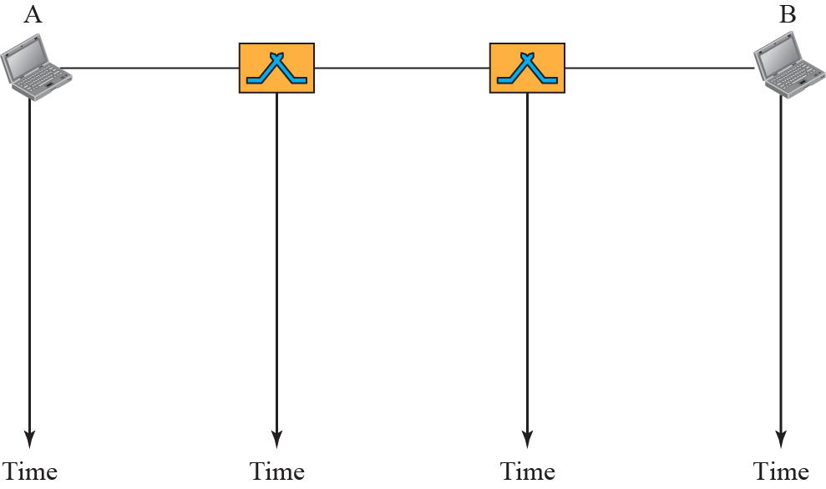



    8.3 Packet Switching
Fig. 8.16 Delay in a virtual-circuit network

Slide 24
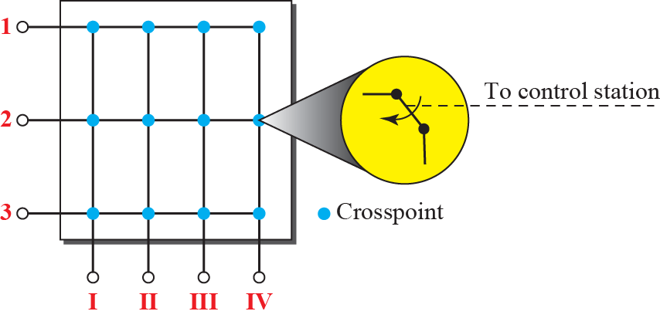
    8.4 Structure of Switch
    8.4 Structure of Switch
    8.4.1 Structure of Circuit Switches
the space-division switch
the time-division switch.
Fig. 8.17 Crossbar switch with three inputs and four outputs

Slide 25
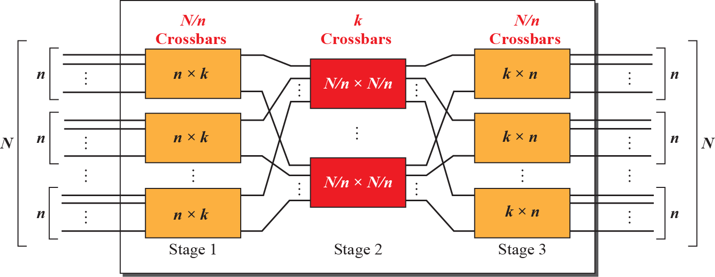
    8.4 Structure of Switch
Fig. 8.18 Multistage switch

Slide 26
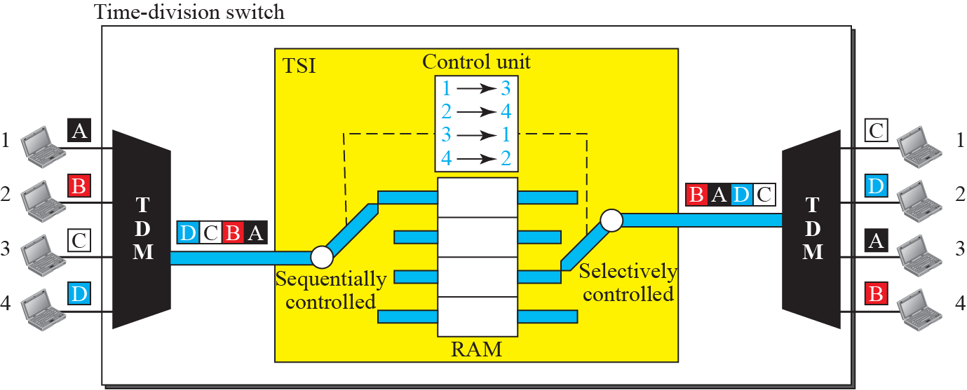
    8.4 Structure of Switch
Fig. 8.19 Time-slot interchange

Slide 27
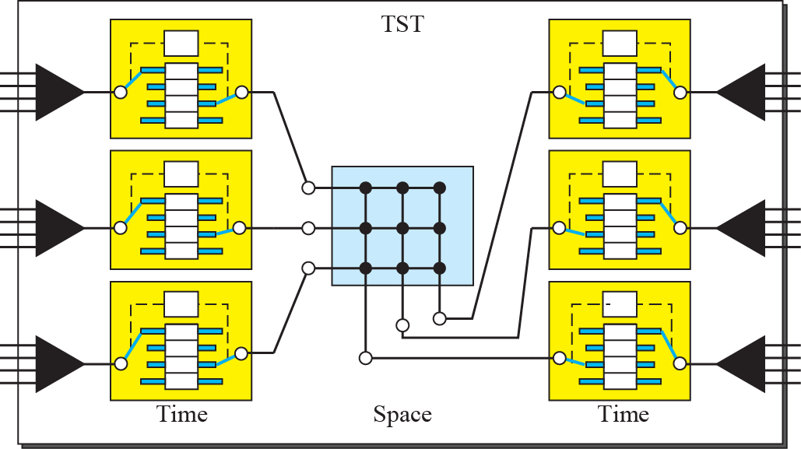
    8.4 Structure of Switch
Fig. 8.20 Time-space-time switch

Slide 28
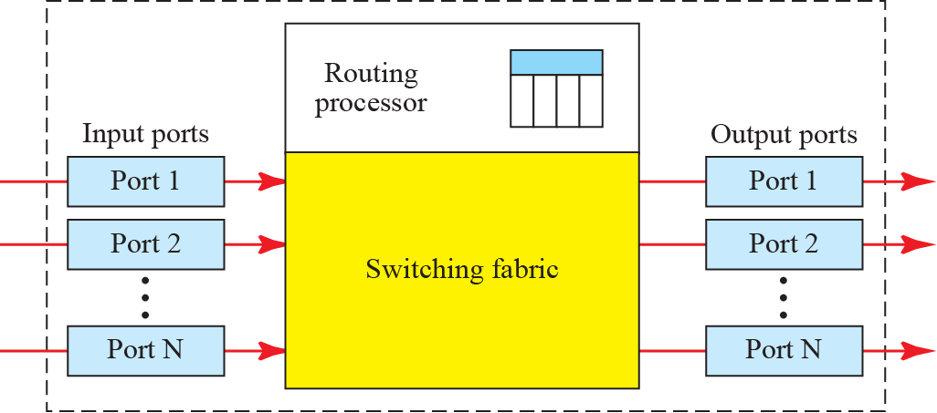
    8.4 Structure of Switch
    8.4.1 Structure of Packet Switches
has four components: input ports, output ports, the routing processor, and the switching fabric, as shown in Figure 8.21.
Fig. 8.21 Packet switch components

Slide 29
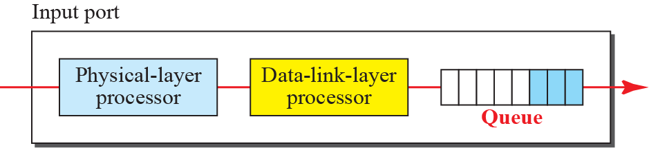
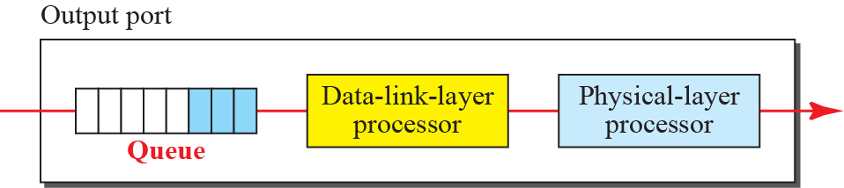
    8.4 Structure of Switch
Fig. 8.22 Input port
Fig. 8.23 Output port

Slide 30
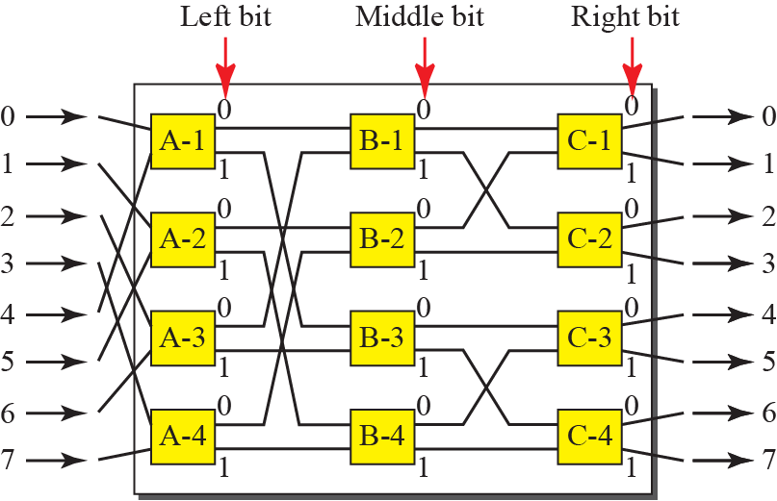
    8.4 Structure of Switch
Fig. 8.24 A banyan switch

Slide 31
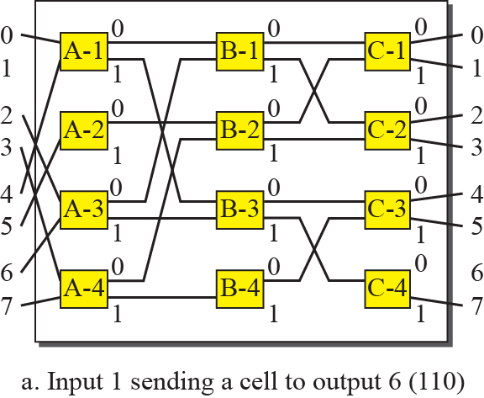
    8.4 Structure of Switch
Fig. 8.25 Example of routing in a banyan switch (part a)

Slide 32
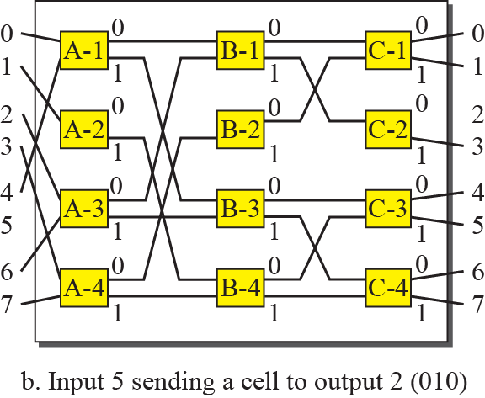
    8.4 Structure of Switch
Fig. 8.25 Example of routing in a banyan switch (part b)

Slide 33
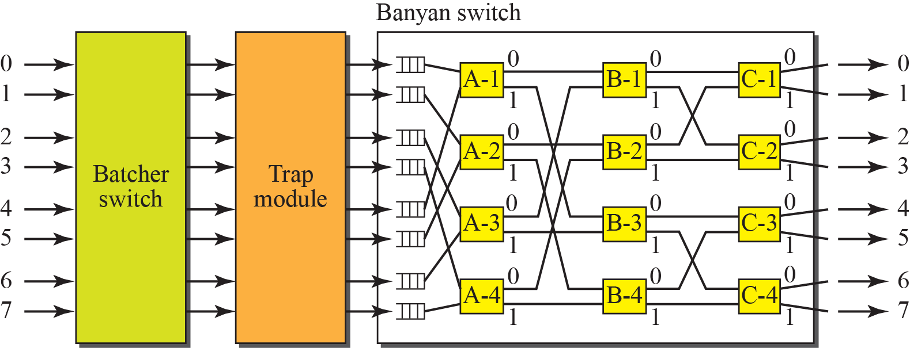
    8.4 Structure of Switch
Fig. 8.26 Batcher-banyan switch

Slide 34
    Homework
Homework
Read textbook pp. 237-252
Next Lecture
Chapter 9. Introduction to Data-Link Layer

